Slide 1
Zombies vs Humans
App
Waleed Judah

Slide 2
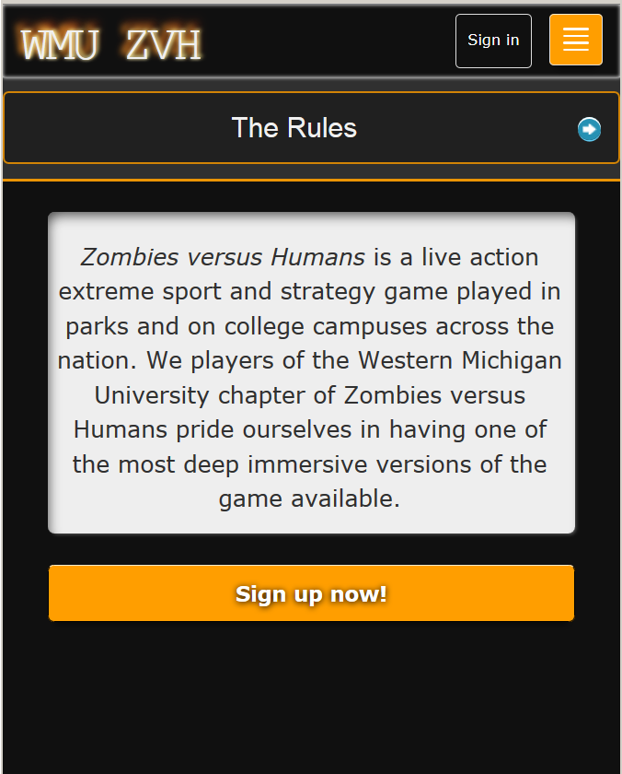
Introduction
The ZvH app
was created to allow humans in
the simulated zombie
apocalypse to use their handheld
technology to communicate and
track zombie locations.

Slide 3
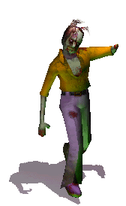
Introduction
The App also allows WMU’s ZvH
council to register the several hundred
players on campus.

Slide 4

Introduction - Need for the App?
ZvH is played by over 300 students on WMU campus.
“Council” can’t track enrollment
No way to send messages
No form of Player 2 Player communication.
Our app fixes these problems!

Slide 5

Introduction
What is ZvH?
•Created in 2005
•A game of tag
•One original zombie
•Humans get converted on Tag
•Zombies die of starvation
•Game over when one group
gone

Slide 6
Introduction: Players
Humans:
•Track down zombies
•Shoot with nerf gun
•Put marker on map
•Communicate in chat
•Bandana on arm
Zombies:
•Search for humans
•“Tag” bitten humans in user directory
•Starves if not eaten in 48 hours
•Bandana on head

Slide 7
Introduction:
Game Administrator:
Oversees the game from the administrator account
Add, delete, and ban users
Final say on disputes and issues
Starts, and ends game

Slide 8
Introduction: Play (Step by Step)
Start out human
2. Chat to organize battle plan
3. Check map for location of zombie horde
4. Take out zombies with nerf gun
5. Get “bitten”(tagged), become a zombie
6. Convert humans
7. Die if not eaten in set amount of time

Slide 9

Background
Problem:
No centralized way to organize large game with proper communication
No effective way for humans to communicate locations of zombies

Slide 10
Background
Problem:
• No way to keep track of tagged zombies
• No way for Game Admin to organize +300 players

Slide 11
Background
Solution:
Ruby on Rails Web App
Secure Database for user data
Global Chat for humans
Map for location marking
User directory for tagging
A Web Application

Slide 12
Background (continued)
Sponsor
The WMU ZvH Chapter
Direct Contact ⇒ Darrius Lane
ZvH Council ⇒
Larger group of game players
•Varying involvement with local chapter
A group of players overseeing campus games

Slide 13
Background (continued)
Technology:
Development DB: SQLite
Production DB: PostgreSQL
Heroku and Google Cloud Engine
•Github
Language: Ruby
Framework: Rails
HTML, CSS, Javascript,
jQuery, Ajax

Slide 14
Design Decisions:
Web app independent of any mobile platform
Develop once for many devices
Standardized set of features to work with
Ruby On Rails Web Framework
Gems, easy to implement
Secure and common at WMU
Heroku
Ease of deployment
Ease of maintenance
SQLite
Major Decisions
Smart Phone Support
Web Framework
Server, Hosting and Database

Slide 15
Design Decisions(continued)
What Heroku does for us:
• Cloud based server and hosting service
• Free for small websites
• Automatic web configuration
• Easy deployment

Slide 16
Design Decisions(continued)
Workflow:
What Heroku does for us:
Online CLI
Linux commands
Allows for Local Machine Development
Easily Push, Pull or clone to local machine

Slide 17
Design Decisions(continued) Workflow: Github
Version Control!
Provides centralized access
Work on code together
Makes backups easy
Display publically
Every version always available

Slide 18
Design
Designed with web usability in mind
Cross-Browser
Cross-Platform
Minimalist design

Slide 19
Design
The ZvH App consists of 3 main features
+
Player Registration Table!
Tag a Player - Convert them to a Zombie!
Mark an oncoming Zombie Horde
Global Chat

Slide 20
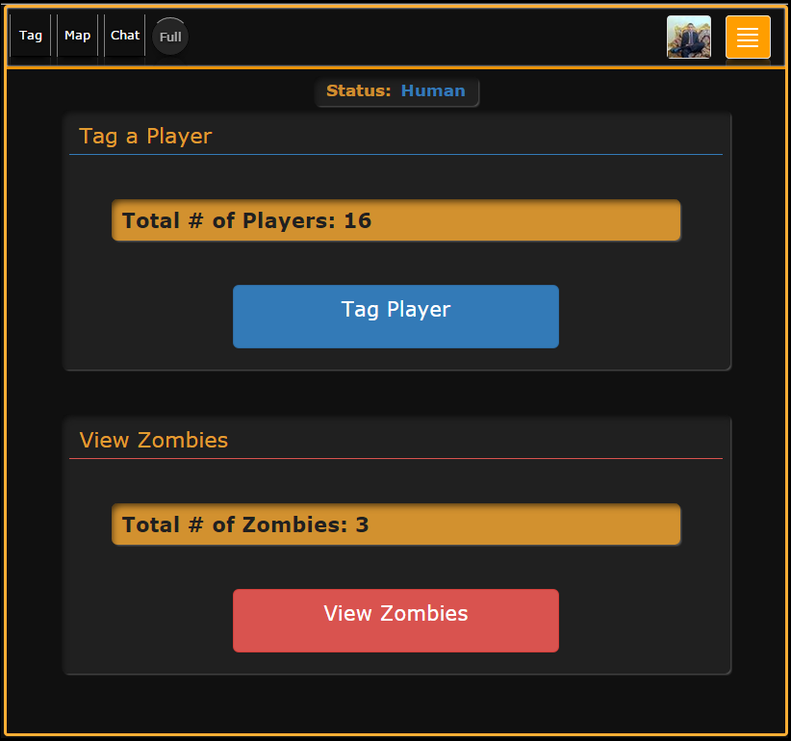
Design - (Tag a Player Page)
Status Indicator:
(Human or Zombie)
View Total # of Humans Indicator
Tag a Player
Total # of Zombies Indicator
View Zombies

Slide 21
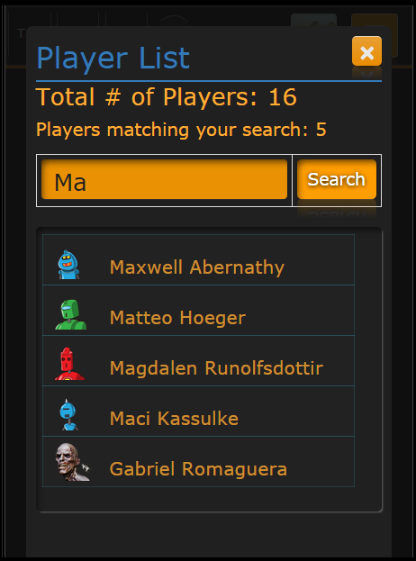
Design - (Tagging a Player)
The Player list, allows users to search by name for other players.
Tagging them as a Zombie on Tap or Click

Slide 22
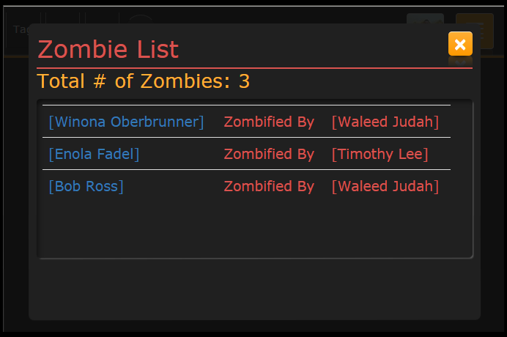
Design - (View Zombies)
The Zombie list, allows users to view the current Zombies in the game and their “tagger”

Slide 23
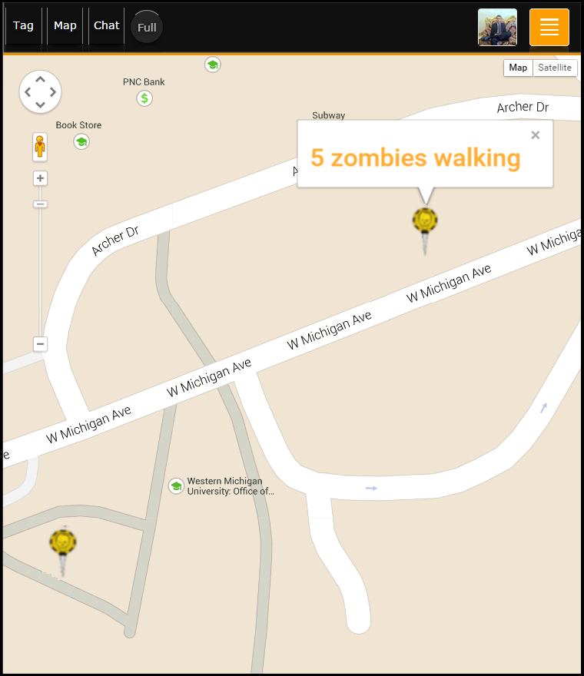
Design - (Map)
Here a Human player can double Tap or Click to place a Zombie Marker.
Zombie Markers are used to signal to other Humans, the location of Incoming Zombies!

Slide 24
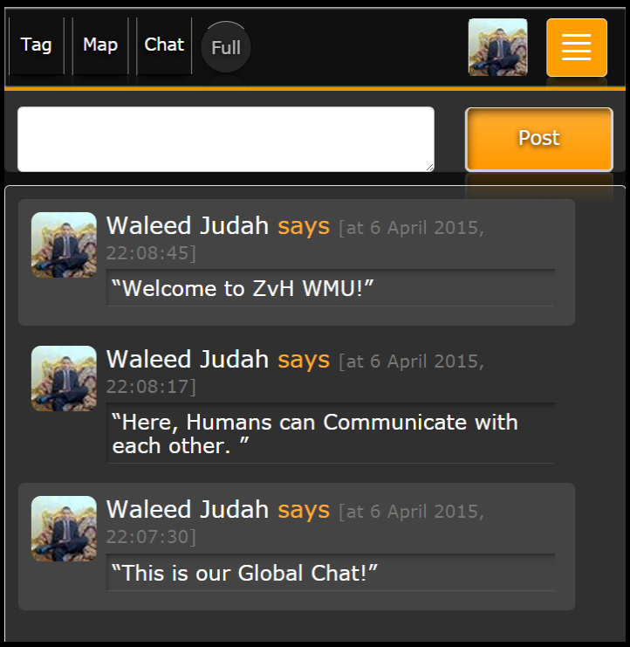
Design - (Global Chat)
Message composer, Human players can quickly write and post a message globally.
Message list, each message includes the players name, avatar and a timestamp

Slide 25
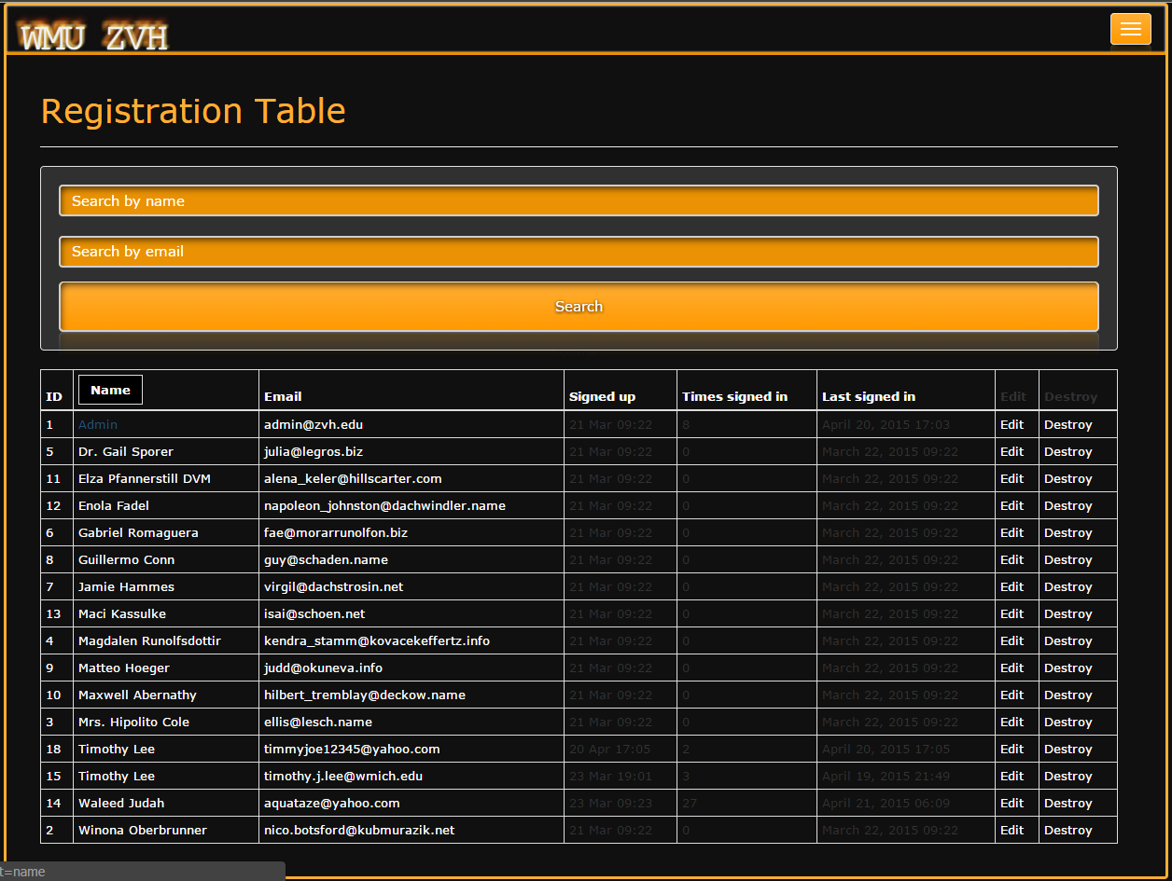
Registration Table
Using the
Registration Table, an administrator can search,
view,
edit
and private message
registered players

Slide 26




Implementation
Ruby on Rails
MVC Framework
HTML5, JavaScript, CSS3
Google Maps API
PostgreSQL
Faye Web Service- (message pushing)
Redundant Hosting
Google Cloud Engine
Heroku
WMU VPS

Slide 27
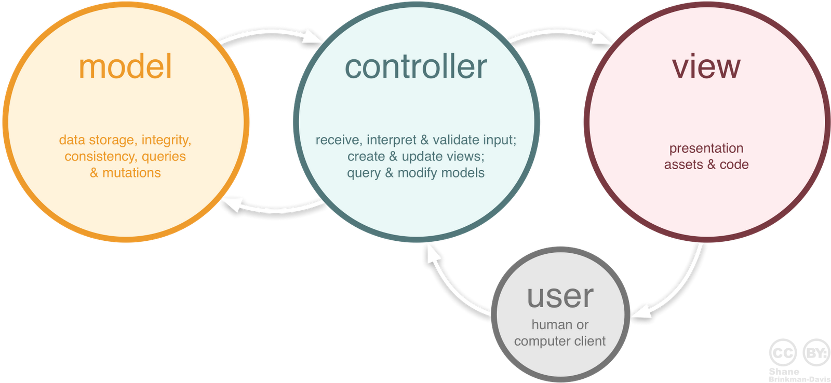
Implementation
MVC - Model View Controller

Slide 28

Implementation
Hosting - Google Compute Cloud
Secure
3.75Gb
1TB
Linux
FTPS
SSH

Slide 29
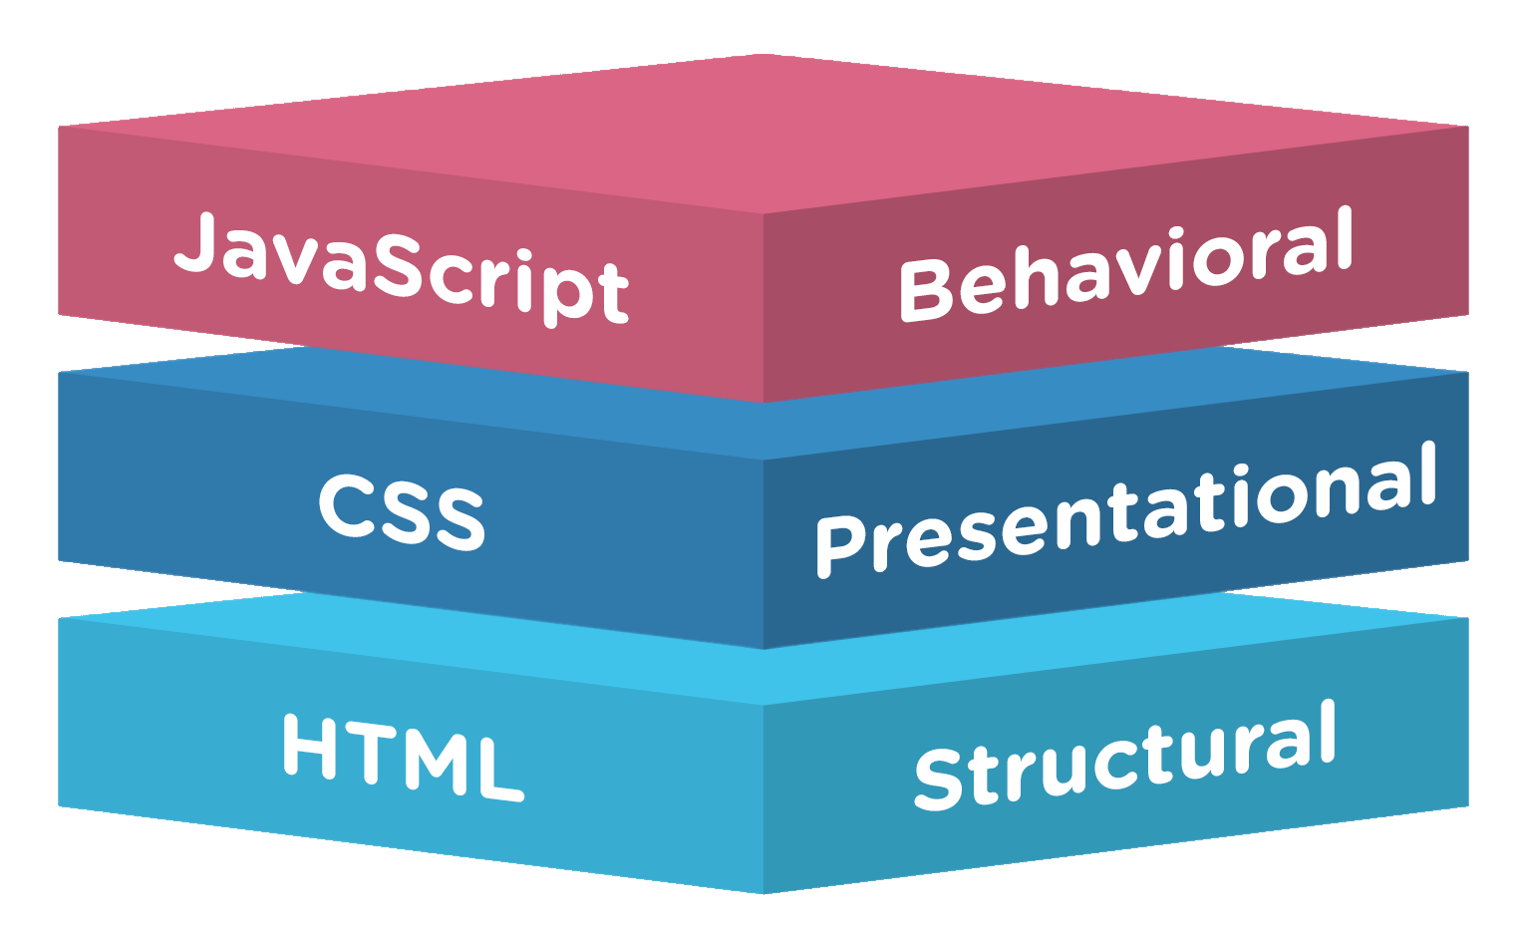
Front End Implementation
HTML5
CSS Styled Layout
JavaScript for Google Maps API

Slide 30
Back End Implementation
Controllers & Models verify and sort data
Controllers send data from server to front end
Ruby tags in HTML
Controllers update the model
Ruby Routes page routes user within site
User, Messages, Map Marker tables

Slide 31
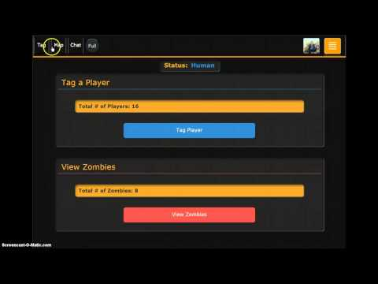
Implementation

Slide 32
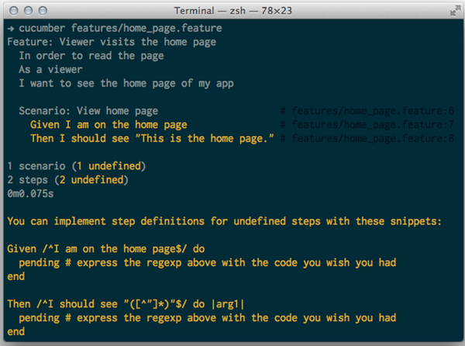
Testing
Cucumber with Capybara - (behavior driven testing)
~65% of our App currently has tests.
Cucumber aims to make its tests readable by clients (AKA, non-programmers).
So, you’ll see here that all your tests are written in what appears to be plain text

Slide 33
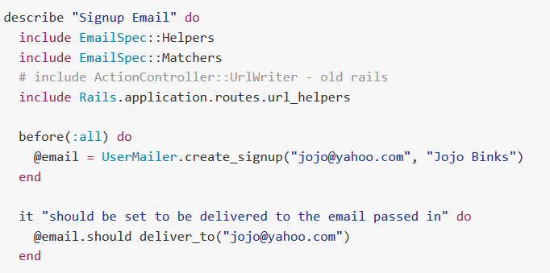
Testing
EmailSpec
allows testing of ActionMailer (a mailing system built into rails)
Factory Girl API
Allows us to quickly seed our test database
The API Generates bogus usernames, emails, profile pics, and more!

Slide 34

Security
Devise and Omniauth Gems for secure user management and login.
Built in SQL injection filter
Users have least privileges to database
API keys held in environment variables
Report button for spamming players
No URL parsing (XXS)

Slide 35

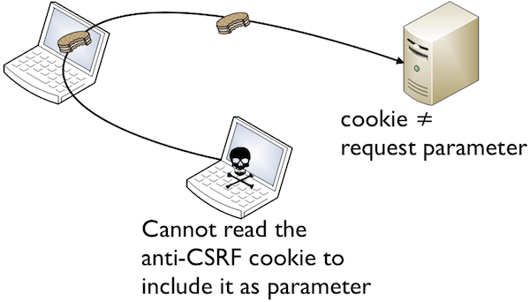
Security
CSRF Forgery Protection && SSL Standard Encryption

Slide 36
Maintenance
Heroku:
Maintenance mode
Static pages to visitors
One-off administrative or maintenance tasks
Customized maintenance mode error pages
Minimal downtime guarantee by Heroku
Version upgrades and legacy support issues handled

Slide 37
Maintenance
WMU VPN:
Dependency, maintenance, upgrade, and legacy issues handled and tested with Heroku
Roll back to stable versions with ruby version control manager(RVM)
Previous code revisions managed with Github
Then deployed to WMU
Ensures app always running

Slide 38
Maintenance
Ongoing Maintenance:
The ZvH council: technically literate, able to provide ongoing maintenance and support.
OS Independent maintenance
WMU’s VPS
Heroku
Google Cloud Engine

Slide 39
Summary:
Problem:
ZvH games have outgrown current resources and organization.
No Player2Player communication
No way to track current game state, locations
No way to handle disputes

Slide 40
Summary
Solution:
Ruby on Rails MVC Web App
Chat & Zombie Location Map for humans
User Directory for tagging
Game administrator account to organize and support live games

